Slide 1
CM2601 Object Oriented Development Week 5

Slide 2
What We Learnt So Far
A real-life scenario can be modeled using objects.
All objects that share similar characteristics or features, that are of the same kind, belong to the same class.
Object Oriented concepts allow to implement real life solutions to real life problems using a programming language.

Slide 3
Object Oriented Principles
Encapsulation
Data hiding using private access modifier and Accessor/ Mutator methods
Inheritance
Inheritance allows a class to use the properties and methods of another class.
Polymorphism
Polymorphism is the ability of an object to take on many forms.
Notes:
REMEMBER: In encapsulation, the variables of a class will be hidden from other classes, and can be accessed only through the methods of their current class. Therefore, it is also known as data hiding.
To achieve encapsulation in Java:
-Declare the variables of a class as private.
-Provide public setter and getter methods to modify and view the variables values.

Slide 4
Java Inheritance Tree and the Object class
All Java classes you ever use or write are in the inheritance tree with “Object” class at the top:
It is also known as the ‘Mother of All Classes”!
Object
String
Shape
Everything else
Square

Slide 5
Every object is an Object
Object obj = new Square() ;
But can only call methods declared by class Object.
Of course, they may be overridden by subclasses.

Slide 6
The Object Class
Every java class has Object as its superclass and thus inherits the Object methods.
Object is a non-abstract class
Many Object methods, however, have implementations that aren’t particularly useful in general
In most cases it is a good idea to override these methods with more useful versions.
In other terms, the Object behaviors are required if you want your objects to correctly work with other class libraries.

Slide 7
Some Object Class methods
Object methods of interest:
equals()
hashcode()
toString()
Other object methods
getClass()
wait, notify, notifyAll (relevant for threaded programming which we will discuss in a few weeks)
Notes:
boolean equals(Object obj)
Indicates whether some other object is "equal to" this one.
Class<?> getClass()
Returns the runtime class of this Object.
int hashCode()
Returns a hash code value for the object.

Slide 8
toString() method
return type
The Object class method
String toString();
is intended to return a readable textual representation of the object upon which it is called. This is great for debugging!
Best way to think of this is using a print statement. If we execute:
System.out.println(someObject);

Slide 9
Final keyword
public static variables are often used to create symbolic constants.
– E.g., Math.PI (static variable PI in class Math)
Such variables are additionally declared final:
– public static final double PI = 3.141;
The value of a final variable cannot be changed by assignment.

Slide 10
Final classes
public final class X { }
The final keyword can be used:
to prevent inheritance, as final class cannot be extended
to create an immutable class like the predefined String class. You can not make a class immutable without making it final.
Notes:
NOTE:
For example, all Wrapper Classes like Integer, Float etc. are final classes. We can not extend them.
One scenario where final is important, when you want to prevent inheritance of a class, for security reasons. This allows you to make sure that code you are running cannot be overridden by someone.
Immutable class means that once an object is created, we cannot change its content. In an Immutable class there are Getter method for all the variables in it. No setters(To not have the option to change the value of the instance variable)

Slide 11
Final methods
Declaring a method final stops, it being overridden by a child class
public final void doSomething() {
doThis() ; ... // Whatever
doThat() ;
}
doThis and doThat can be overridden but not doSomething.
A constructor cannot be final
Notes:
Demo

Slide 12
Why use final?
Gives the class programmer control.
Not all classes or methods are designed to be subclassed or overridden.
Can explicitly enforce design decisions.
Notes:
Final class cannot be extended. Final classes are created so the methods implemented by that class cannot be overridden. Best example is Math final class of java. If a class is final, all its methods are also final.
Syntax of final class
final class className
{
// body of class
}

Slide 13
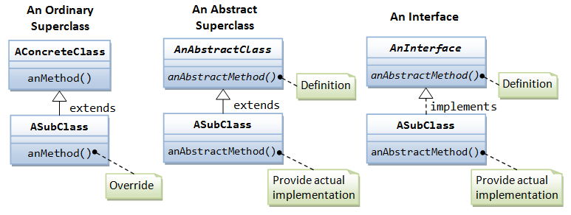
UML Class diagrams
Abstract classes and interfaces are represented by placing the "<<abstract>>" stereotype and the "<<interface>>” stereotype respectively, above the class name or showing the class name in italics.

Slide 14
What is Design Pattern
Christopher Alexander says “ Each pattern describes a problem which occurs over and over again in our environment, and then describes the core of the solution to that problem, in such a way that you can use this solution a million times over, without ever doing it the same way twice”
A design pattern is a descriptions of communicating objects and classes that are customized to solve a general design problem in a particular context
A pattern is made by four elements:
Name
Problem
Solution
Consequences

Slide 15
Design Pattern - Name
Describe a design problem and its solution in a word or two
Is used to talk about design pattern with our colleagues
Used in the documentation
Increase our design vocabulary
Must be coherent and evocative
Notes:
Having a vocabulary for patterns lets us talk about them – developing a catalog of patterns
Higher level of abstraction
Hard part finding good names

Slide 16
Design Pattern - Problem
Describes when to apply the patterns
Explains the problem and its context
Sometimes include a list of conditions that must be met before it makes sense to apply the pattern
Must occur repeatedly in our environment
Notes:
Problem and its context: how to represent algorithms as objects

Slide 17
Design Pattern - Solution
Does not describe a concrete design or implementation
Must be well proven in some projects
Describes the elements that make up the design, their relationships, responsibilities and collaborations
Notes:
Does not describe a concrete implementation because a pattern is like a template that can be applied in many different situation.
It provides an abstract description

Slide 18
Design Pattern - Consequences
Results and trade-offs of applying the pattern
Helpful for describe design decisions, for evaluating design alternatives
Benefits of applying a pattern
Impacts on a system’s flexibility, extensibility or portability
Notes:
To understand the cost and benefits

Slide 19
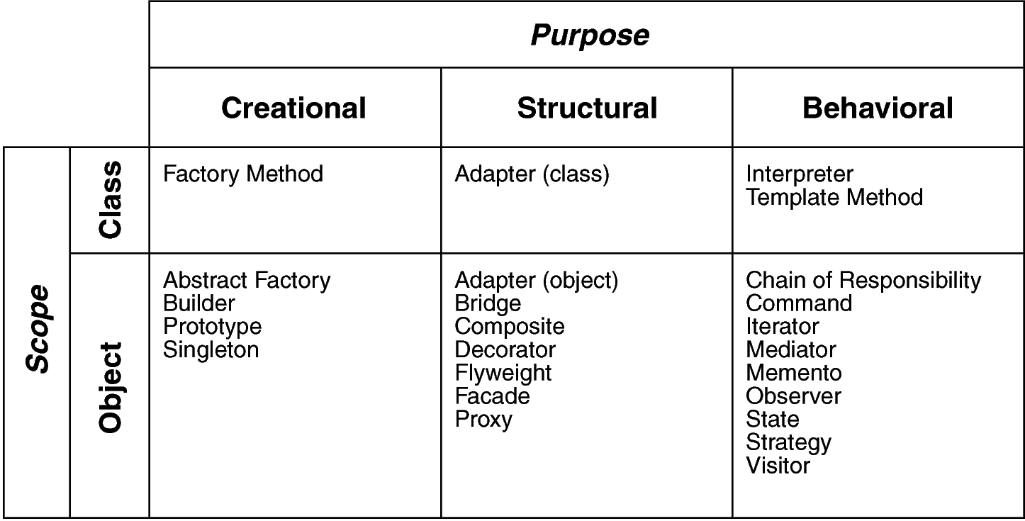
Classification of Design Pattern
Scope: domain over which a pattern applies
Purpose: reflects what a pattern does
Notes:
Scope: specifies whether the pattern applies primary to classes or object. Class patterns deal with relationship between classes and their subclasses. (Relationship such as inheritance that is the most used…almost every pattern use it) Satic, fixed at run time.
Object patterns deal with object relationships that can change at run time that are dynamic.
Creational: concern object creation, Structural deal with composition of classes and objects, behavioal is how class and objects interacts

Slide 20
Template Method Pattern
Intent/Problem: Define the skeleton of an algorithm in an operation, deferring some steps to client subclasses. Template Method lets subclasses redefine certain steps of an algorithm without changing the algorithm's structure.
Solution: The component designer decides which steps of an algorithm are invariant (or standard), and which are variant (or customizable). The invariant steps are implemented in an abstract base class, while the variant steps are either given a default implementation, or no implementation at all.
Notes:
emplate method should consists of certain steps whose order is fixed and for some of the methods, implementation differs from base class to subclass. Template method should be final.
Most of the times, subclasses calls methods from super class but in template pattern, superclass template method calls methods from subclasses, this is known as Hollywood Principle INVERSION OF CONTROL “don’t call us, we’ll call you.”.
Methods in base class with default implementation are referred as Hooks and they are intended to be overridden by subclasses, if you want some of the methods to be not overridden, you can make them final, for example in our case we can make buildFoundation() method final because if we don’t want subclasses to override it.

Slide 21
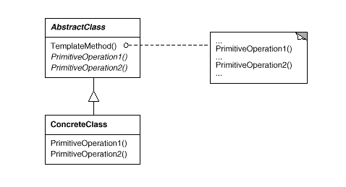
Template Method Pattern
The key point to mention is that template method should be final, so that subclass can not override and change steps of the algorithm, but same time individual step should be abstract, so that child classes can implement them.
Notes:
The AbstractClass contains the template method. The abstract versions of the operations used in the template method.
There may be many ConcreteClasses, each implementing the full set of operations required by the template method.
The ConcreteClasses implements the abstract operations, which are called when the templateMethod() needs them.
The template method makes use of the primativeOperations to implement an algorithm. It is decoupled from the actual implementation of these operations

Slide 22
Example Sandwich Factory
Banas Derek. (n.d.). Template Method Design Pattern Tutorial. Retrieved October 28, 2022, from https://www.newthinktank.com/2012/10/template-method-design-pattern-tutorial/

Slide 23
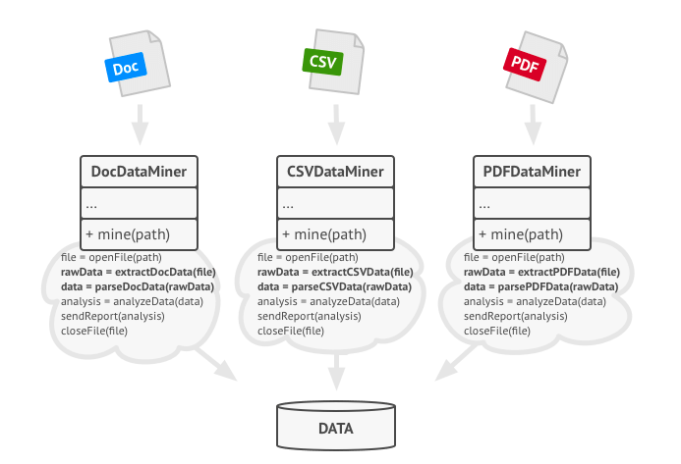
Example
Suppose to create a data mining application that analyzes corporate documents. Users feed the app documents in various formats (PDF, DOC, CSV), and it tries to extract meaningful data from these docs in a uniform format.
Notes:
you noticed that all three classes have a lot of similar code. While the code for dealing with various data formats was entirely different in all classes, the code for data processing and analysis is almost identical. Wouldn’t it be great to get rid of the code duplication, leaving the algorithm structure intact?

Slide 24
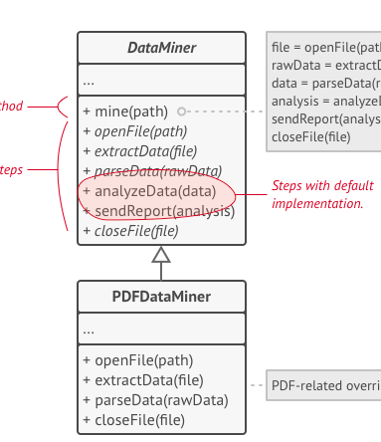
Solution using Template Method Pattern
Template method breaks the algorithm into steps, allowing subclasses to override these steps but not the actual method.

Slide 25
Next
Collections

